Slide 2
CONTENTS: 1.PARALLELS 2.IMPORTANT PARALLELS 3.MERIDIANS 4.IMPORTANT MERIDIANS 5.HOW TO LOCATE PLACES ON THE GLOBE
2.PARALLEL AND MERIDIANS

Slide 3
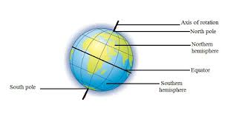
AXIS –IMAGINARY LINE DRAWN THROUGH THR CENTRE OF THE EARTH POLES – END POINTS ON THE AXIS. NORTH POLE- POINT ON THE TOP SOUTH POLE- POINT ON THE BOTTOM
ABOUT EARTH

Slide 4
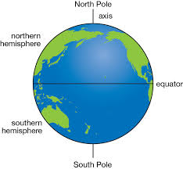
EQUATOR

Slide 5
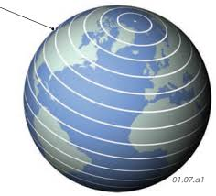
Chapter 2/social/karunambigai/Sns Academy
PARALLELS
THE IMAGINARY LINES WHICH DRAWN FROM EAST TO WEST ON A GLOBE.
THE EQUATOR IS THE LONGEST PARALLEL

Slide 6
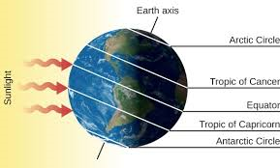
THE TROPIC OF CANCER (23½° N ) THE TROPIC OF CAPRICORN(23½° S) THE ARCTIC CIRCLE (66 ½° N) THE ANTARCTIC CIRCLE (66½° S) EQUATOR (0°)
IMPORTANT PARALLELS

Slide 7
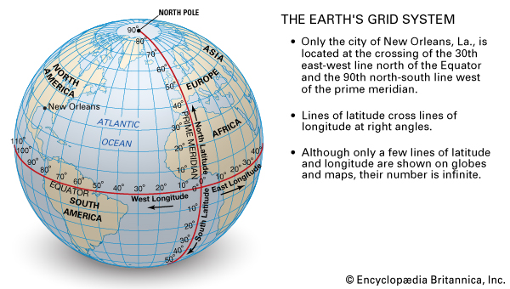
PARALLELS ARE DRAWN AT A INTERVALS OF ONE DEGREE 90 PARALLELS ARE IN NORTHERN HEMISPHERE. 90 PARALLELS ARE IN SOUTHERN HEMISPHERE. 181 PARALLELS ARE THERE INCLUDING EQUATOR
NUMBERING OF PARALLELS

Slide 8
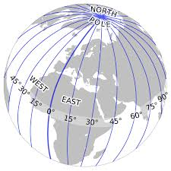
Longitude is measured by imaginary lines that run around the Earth vertically (up and down) and meet at the North and South Poles. These lines are known as meridians.
MERIDIANS

Slide 11
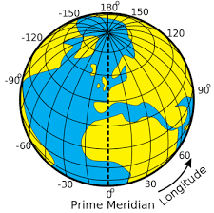
THE MERIDIAN WHICH PASSES THROUGH GREENWICH WAS MARKED 0° IT NAMES AS PRIME MERIDIAN. MERIDIANS ARE ALSO DRAWN AT ONE DEGREE. 180 MERIDIANS ARE TOWARDS THE EAST. 180 MERIDIANS ARE TOWARDS THE WEST 360 MERIDIANS ARE THERE.
NUMBERING OF LONGITUDES
.

Slide 12
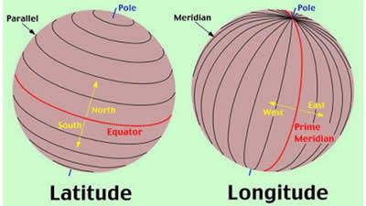
DIFFERENCE BETWEEN LATITUDE AND LONGITUDE
LATITUDES | LONGITUDES
THE IMAGINARY LINES WHICH DRAWN HORIZONTALLY FROM EAST TO WEST | THE IMAGINARY LINES WHICH DRAWN VERTICALLY FROM NORTH TO SOUTH
IT IS ALSO KNOWN AS PARALLELS. | IT IS ALSO KNOWN AS MERIDIANS
181 PARALLELS ARE THERE | 360 MERIDIANS ARE THER
ALL PARALLELS ARE LOCATED AT AN EQUAL DISTANCE | ALL MERIDIANS ARE OF THE SAME LENGTH

Slide 13
GRID

